Slide 1
Systems Analysis and Design 5th Edition Chapter 11. Data Storage Design
Alan Dennis, Barbara Haley Wixom, and Roberta Roth
© Copyright 2011 John Wiley & Sons, Inc.
11-‹#›

Slide 2
Chapter 11 Outline
Data storage formats.
- Files.
- Databases.
Moving from logical to physical data models.
Optimizing data storage.
© Copyright 2011 John Wiley & Sons, Inc.
11-‹#›

Slide 3
INTRODUCTION
The data storage function is concerned with how data is stored and handled by programs that run the system.
Data storage design is to
- select the data storage format;
- convert the logical data model created during analysis into a physical data model to reflect the implementation decision;
- ensure that DFDs and ERDs balance; and
- design the selected data storage format to optimize its processing efficiency.
© Copyright 2011 John Wiley & Sons, Inc.
11-‹#›

Slide 4
Data Storage Formats
Two main types of data storage formats:
Files: electronic lists of data, optimized to perform a particular transaction
Database: a collection of groupings of information that are related to each other in some way
Database Management System (DBMS): software that creates and manipulates the databases

Slide 5
Files
A data file contains an electronic list of information that is formatted for a particular transaction.
Typically, files are organized sequentially.
Records can be associated with other records by pointers.
Sometimes files are called linked Lists because of the way the records are linked together using pointers.
© Copyright 2011 John Wiley & Sons, Inc.
11-‹#›

Slide 6
Types of Files
Master files – store core information that is important to the application
Look-up files – contain static values
Transaction files – store information that can be used to update a master file
Audit files – record “before” and “after” images of data as the data is altered
History files (or archive files) – store past transactions

Slide 7

File based DB: appointment record
© Copyright 2011 John Wiley & Sons, Inc.
11-‹#›

Slide 8
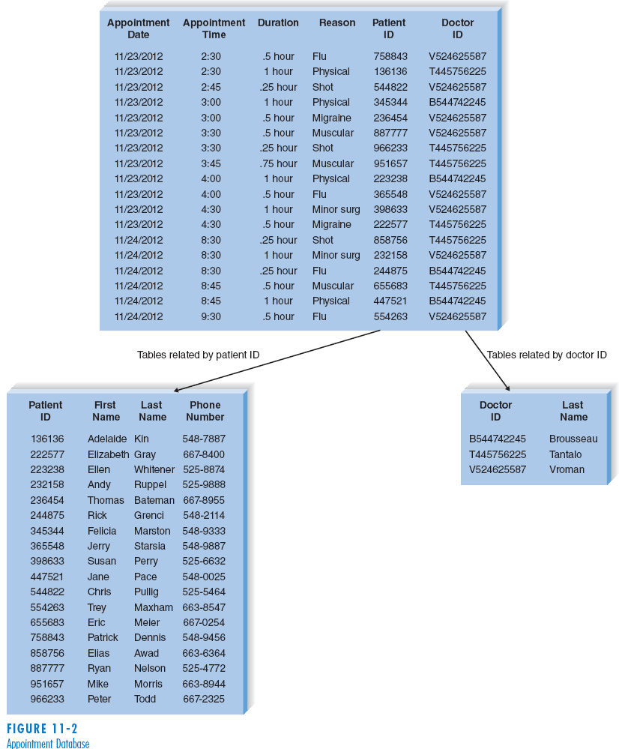
Example of database:
© Copyright 2011 John Wiley & Sons, Inc.
11-‹#›

Slide 9
Databases
There are many types of databases:
Relational database
Object database
Multidimensional database
NoSQL database
© Copyright 2011 John Wiley & Sons, Inc.
11-‹#›

Slide 10
Relational Databases
The relational database is the most popular kind of database for application development today.
A relational database is based on collections of tables, each of which has a primary key.
The tables are related to each other by the placement of the primary key from one table into the related table as a foreign key.
Most relational database management systems (RDBMS) support referential integrity, or the idea of ensuring that values linking the tables together are valid and correctly synchronized.
Structured Query Language (SQL) is the standard language for accessing the data in the tables.
© Copyright 2011 John Wiley & Sons, Inc.
11-‹#›

Slide 11
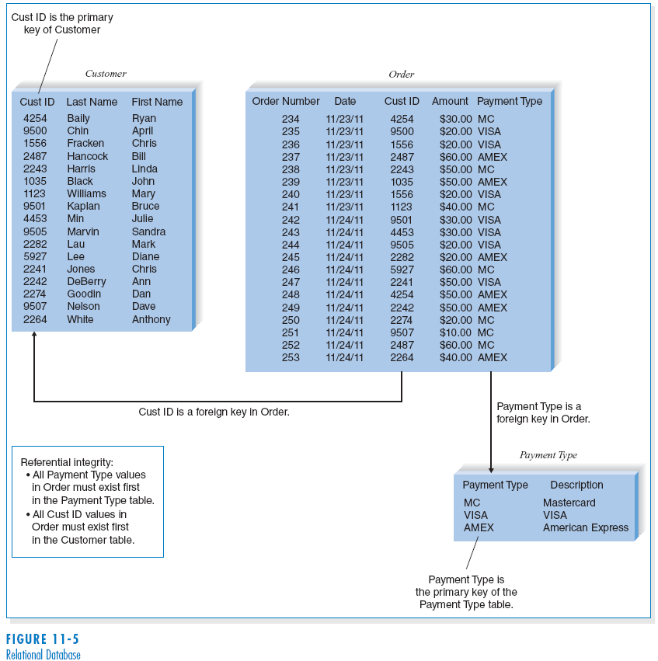
(cont’d)
Relational
database
example
© Copyright 2011 John Wiley & Sons, Inc.
11-‹#›

Slide 12
Object Databases
The object database, or object-oriented database, is based on the premise of object orientation that all things should be treated as objects that have both data (attributes) and processes (behaviors).
Changes to one object have no effect on other objects because the attributes and behaviors self-contained, or encapsulated, within each one.
This encapsulation allows objects to be reused.
© Copyright 2011 John Wiley & Sons, Inc.
11-‹#›

Slide 13
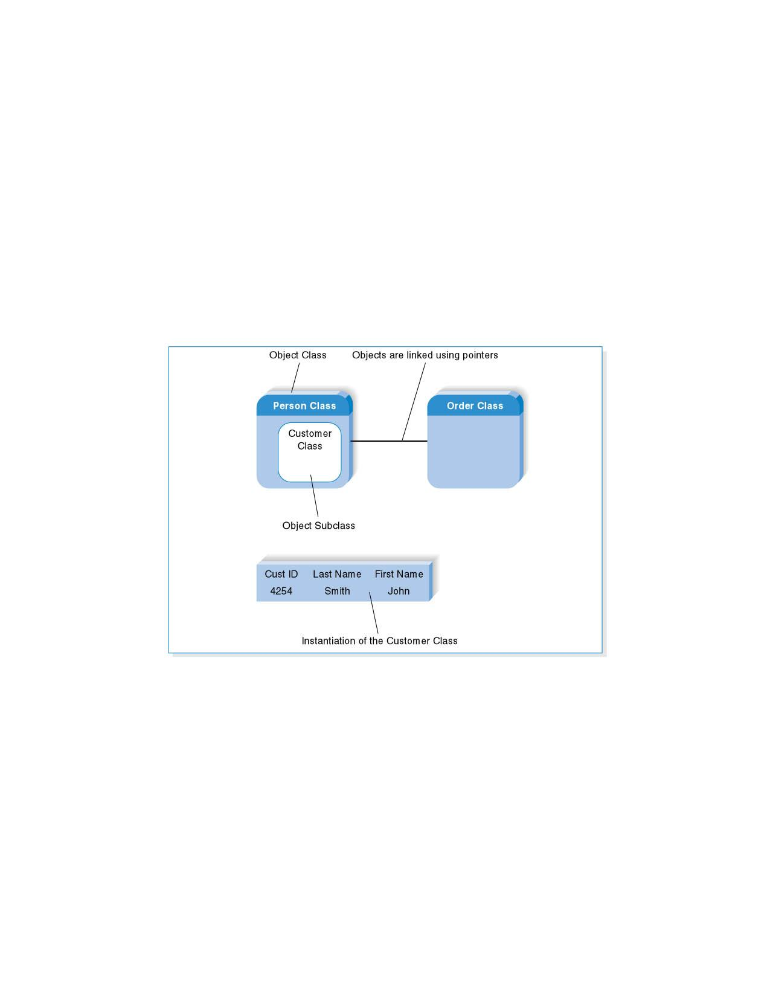
(cont’d)
Object Database Example
© Copyright 2011 John Wiley & Sons, Inc.
11-‹#›

Slide 14
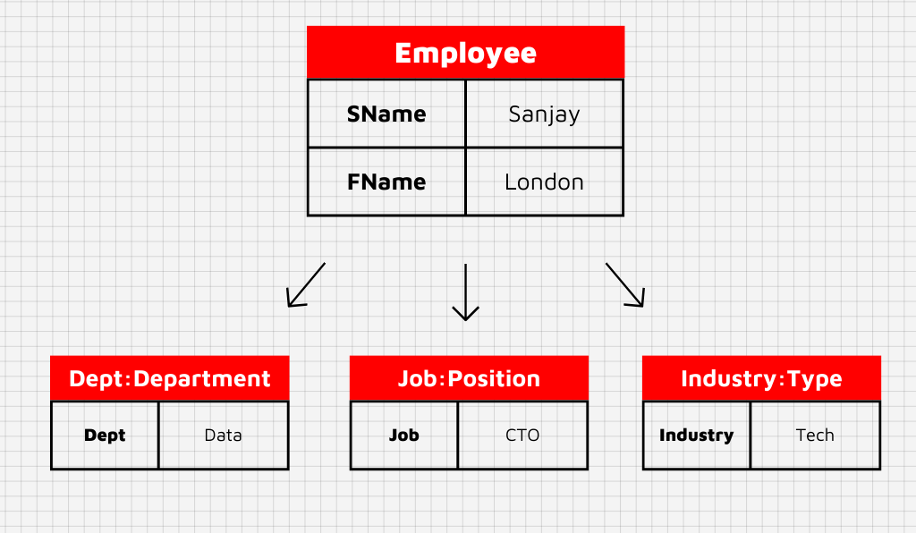
Object Database Example
© Copyright 2011 John Wiley & Sons, Inc.
11-‹#›

Slide 15
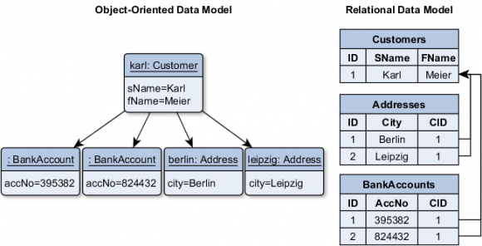
Object Database Example
© Copyright 2011 John Wiley & Sons, Inc.
11-‹#›

Slide 16
Multidimensional Databases
A multidimensional database is a type of relational database that is used extensively in data warehousing.
Data warehousing is the practice of taking and storing data in a data warehouse (i.e., a large database) that supports decision support systems (DSS).
Data marts are smaller databases based on data warehouse data, and support DSS for specific departments or functional areas of the organization.
© Copyright 2011 John Wiley & Sons, Inc.
11-‹#›

Slide 17
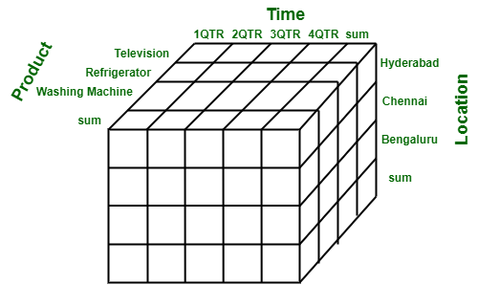
Multidimensional Databases
© Copyright 2011 John Wiley & Sons, Inc.
11-‹#›

Slide 18
NoSQL Databases
Newest database approach; not based on the relational model or SQL
Rapid processing on replicated database servers in the cloud
Various types include:
Document-oriented databases: manage collection of documents of varying forms and structures (example: Mongo DB)
Wide column databases: store data in records holding very large numbers of dynamic columns (potentially billions of columns). Example: Bigtable, Cassandra, Dynamo
Graph databases: a collection of nodes and edges using graph theory to store, map, and query relationships

Slide 19
Selecting a Storage Format
Comparing Data Storage Formats
 | Files | Legacy databases | Relational databases | Object databases | Multidimensional databases | NoSQL databases
Major strengths | Files can be designed for fast performance; good for short-term data storage. | Very mature products | Leader in the database market; can handle fast updating and querying needs | Able to handle complex data | Configured to answer business intelligence questions quickly | Designed for huge, varied data sets
Major weaknesses | Redundant data; data must be updated using programs. | Not able to store data as efficiently; limited future | Cannot handle complex data | Limited market acceptance; skills are hard to find. | Highly specialized use; skills are hard to find | New in the market, highly specialized use; skills are hard to find
Data types supported | Simple | Not recommended for new systems | Simple | Complex (e.g., video, audio, images) | Aggregated | Mixed data sets with structured and unstructured components
Application system types supported | Transaction processing | Not recommended for new systems | Transaction processing and decision making | Transaction processing | Business intelligence | Business intelligence; finding patterns and relationships in mixed data
Existing data formats | Organization dependent | Organization dependent | Organization dependent | Organization dependent | Organization dependent | Organization dependent
Future needs | Limited future prospects | Poor future prospects | Good future prospects | Uncertain future prospects | Uncertain future prospects | New, uncertain future prospects
© Copyright 2011 John Wiley & Sons, Inc.
11-‹#›

Slide 20
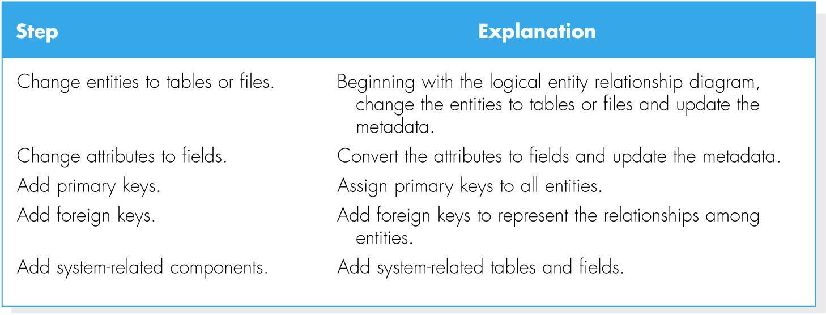
MOVING FROM LOGICAL TO PHYSICAL
© Copyright 2011 John Wiley & Sons, Inc.
11-‹#›

Slide 21
Conceptual, Logical and Physical
Conceptual, logical and physical model or ERD are three different ways of modeling data in a domain.
Business analyst uses conceptual and logical model for modeling the data required and produced by system from a business angle
while database designer refines the early design to produce the physical model for presenting physical database structure ready for database construction.
© Copyright 2011 John Wiley & Sons, Inc.
11-‹#›

Slide 22
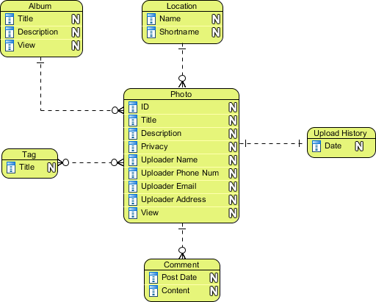
Conceptual Model
Conceptual ERD models information gathered from business requirements.
Entities and relationships modeled in such ERD are defined around the business's need.
The need of satisfying the database design is not considered yet.
© Copyright 2011 John Wiley & Sons, Inc.
11-‹#›

Slide 23
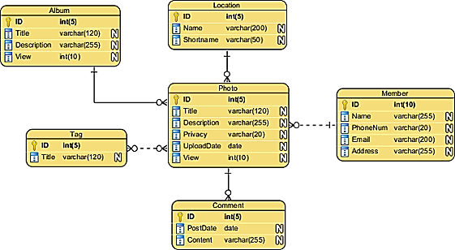
Logical Model
Logical ERD also models information gathered from business requirements. It is more complex than conceptual model in that column types are set. Note that the setting of column types is optional and if you do that, you should be doing that to aid business analysis. It has nothing to do with database creation yet.

Slide 24
Physical Model
Actual design blueprint of a relational database.
It represents how data should be structured and related in a specific DBMS so it is important to consider the convention and restriction of the DBMS you use when you are designing a physical ERD.
This means that an accurate use of data type is needed for entity columns and the use of reserved words has to be avoided in naming entities and columns.
Besides, database designers may also add primary keys, foreign keys and constraints to the design.
© Copyright 2011 John Wiley & Sons, Inc.
11-‹#›

Slide 25
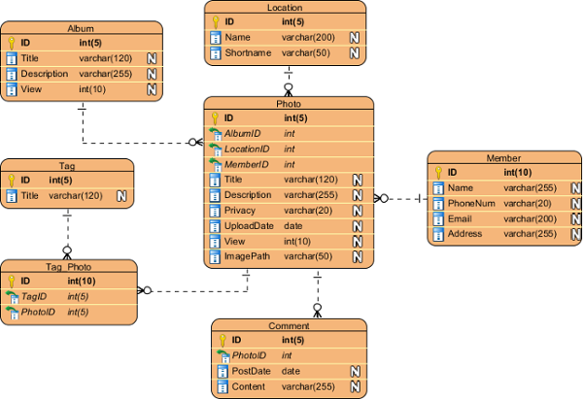
Physical Model
11-‹#›

Slide 26
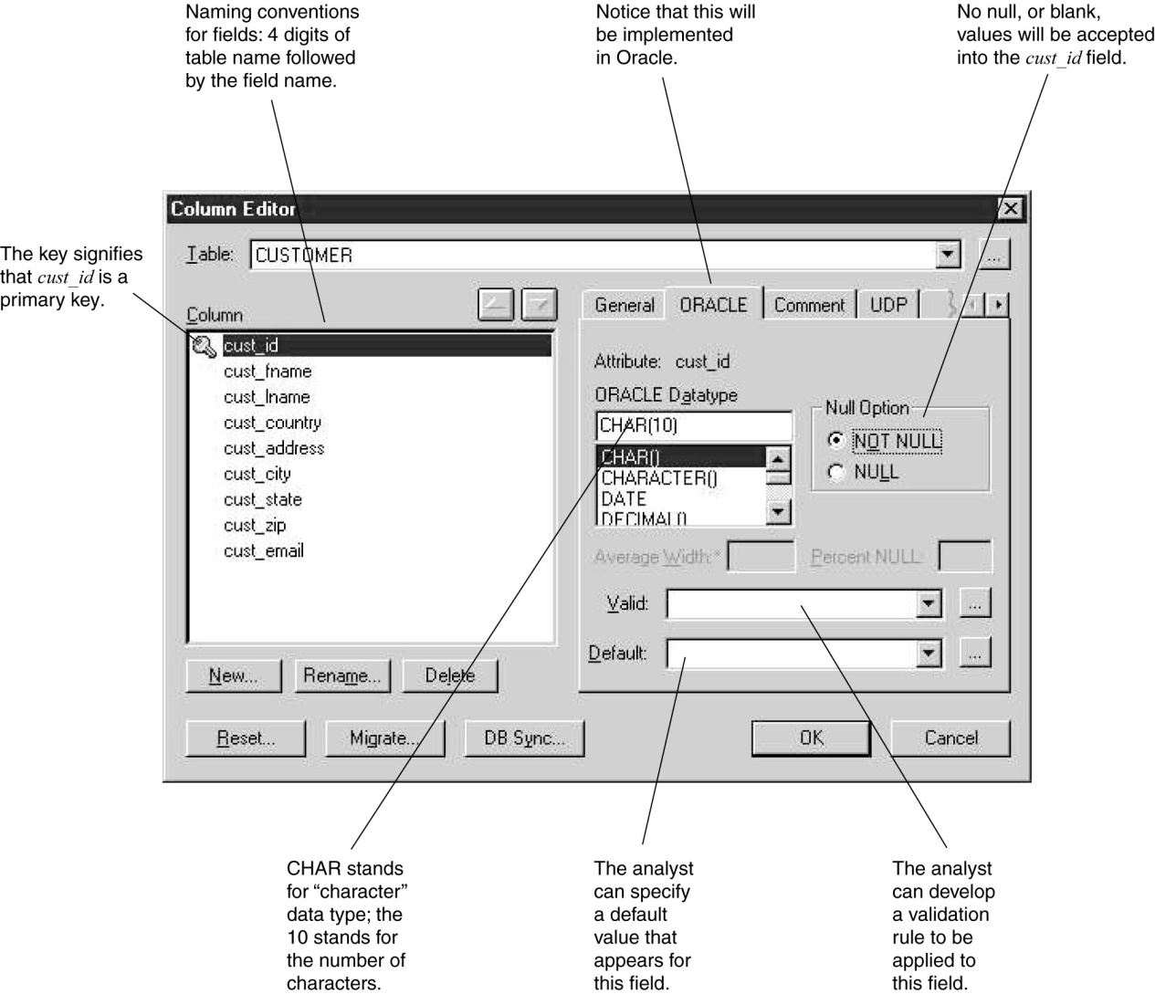
Metadata
© Copyright 2011 John Wiley & Sons, Inc.
11-‹#›

Slide 27
OPTIMIZING DATA STORAGE
The data storage format is now optimized for processing efficiency.
There are two primary dimensions in which to optimize a relational database: for storage efficiency and for speed of access.
© Copyright 2011 John Wiley & Sons, Inc.
11-‹#›

Slide 28
Optimizing Storage Efficiency
The most efficient tables in a relational database in terms of storage space have no redundant data and very few null values.
Normalization is the best way to optimize data storage for efficiency.
© Copyright 2011 John Wiley & Sons, Inc.
11-‹#›

Slide 29
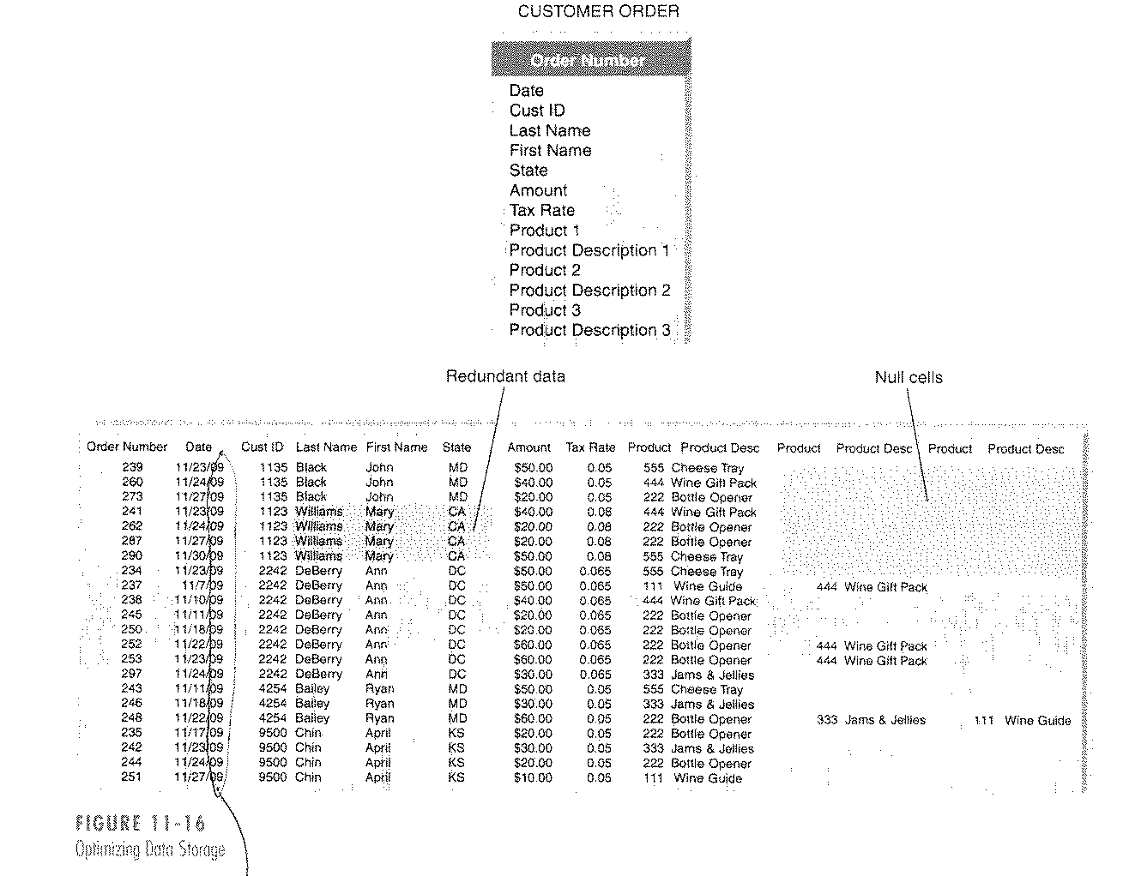
(cont’d)
Optimizing data storage
© Copyright 2011 John Wiley & Sons, Inc.
11-‹#›

Slide 30
Optimizing Access Speed
After having optimized the data model design for data storage efficiency, the end result is that data are spread out across a number of tables.
For a large relational database, it is necessary to optimize access speed.
There are several techniques of optimizing access speed:
Denormalization
Clustering
Indexing
Estimating the size of data for hardware planning
© Copyright 2011 John Wiley & Sons, Inc.
11-‹#›

Slide 31
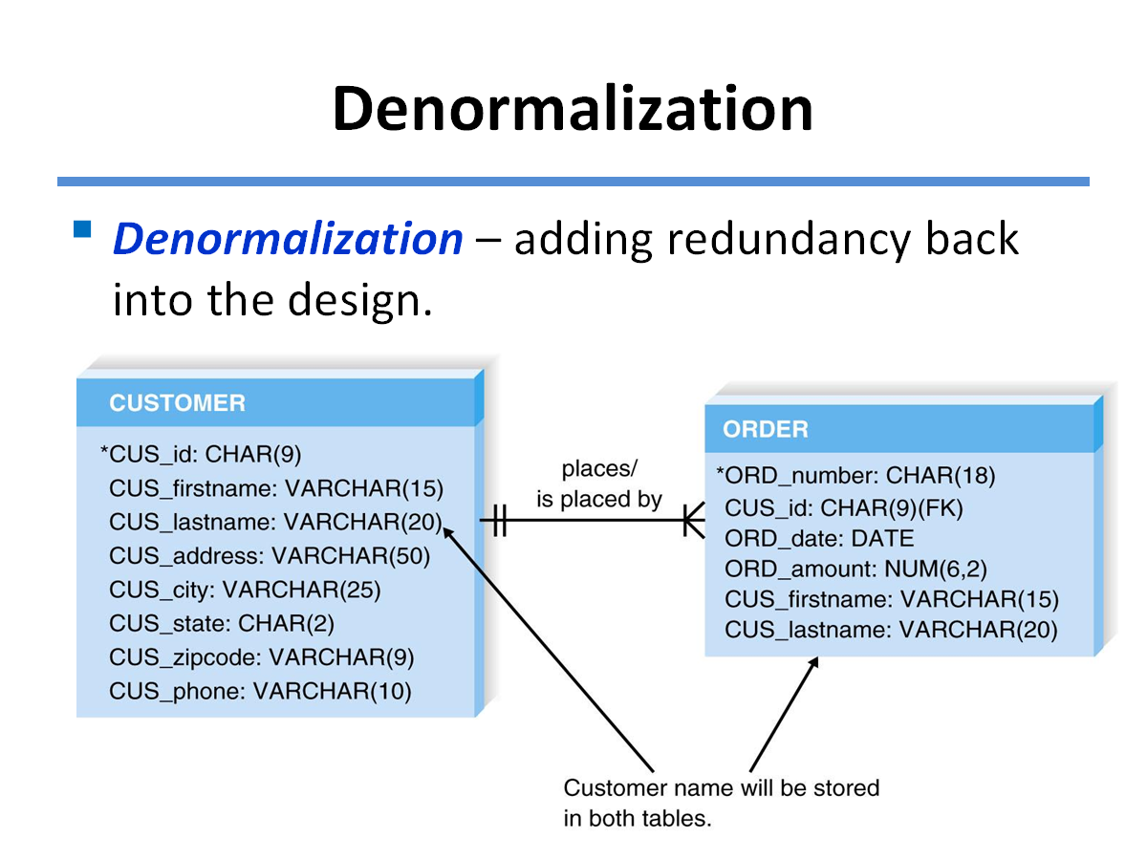

Slide 32
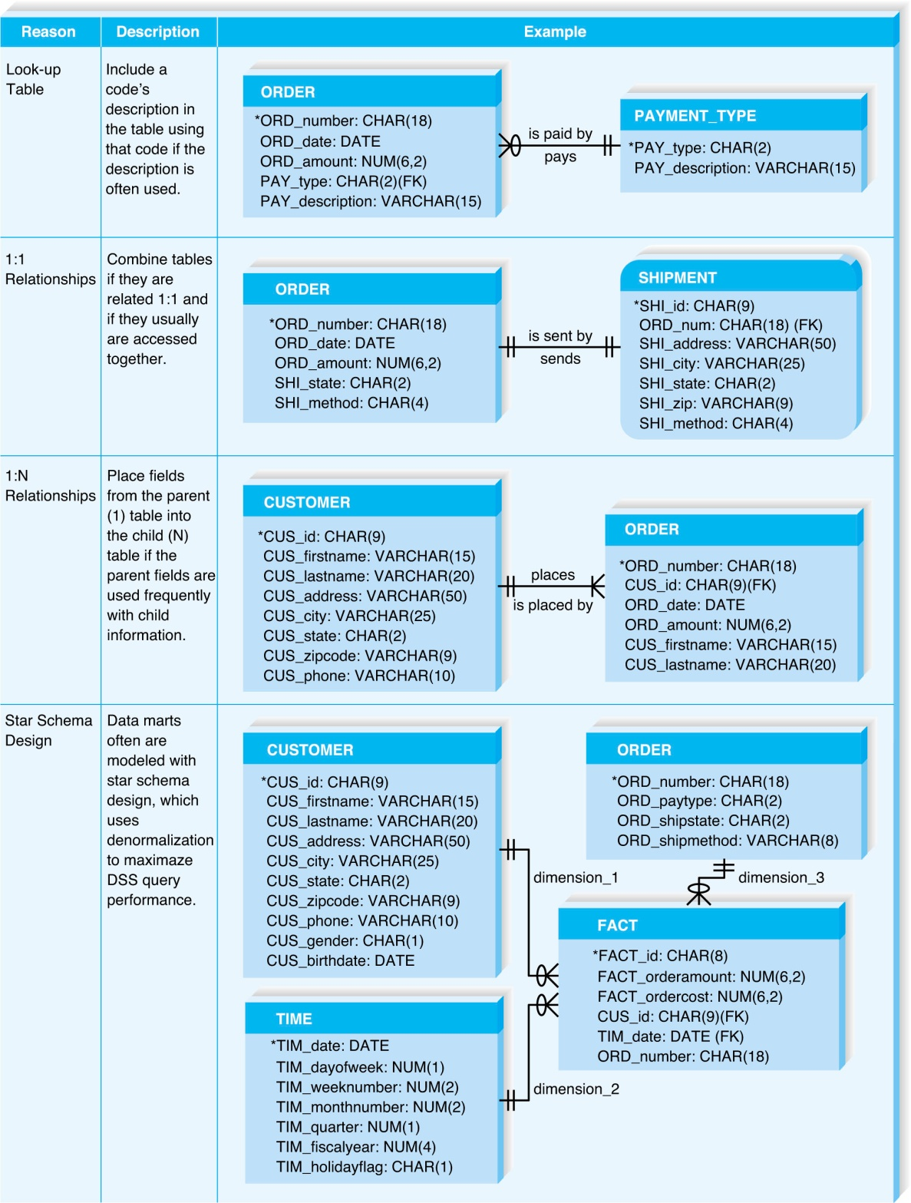
(cont’d)
There are four reasons for de-normalization.
© Copyright 2011 John Wiley & Sons, Inc.
11-‹#›

Slide 33
Clustering
Clustering – placing records together physically so that like records are stored close together.
Intrafile clustering – Similar records in the table are stored together.
Interfile clustering – Combining records from more that one table that typically are retrieved together.
© Copyright 2011 John Wiley & Sons, Inc.
11-‹#›

Slide 34
Indexing
An index in data storage is a minitable (similar to an index of a book) that contains values from one or more columns in a table and the location of the values within the table.
Indexes require overhead in that they take up space on the storage.
© Copyright 2011 John Wiley & Sons, Inc.
11-‹#›

Slide 35
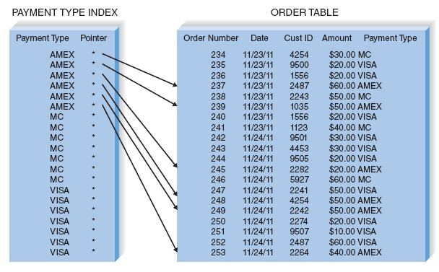
(cont’d)
Example of indexing
© Copyright 2011 John Wiley & Sons, Inc.
11-‹#›

Slide 36
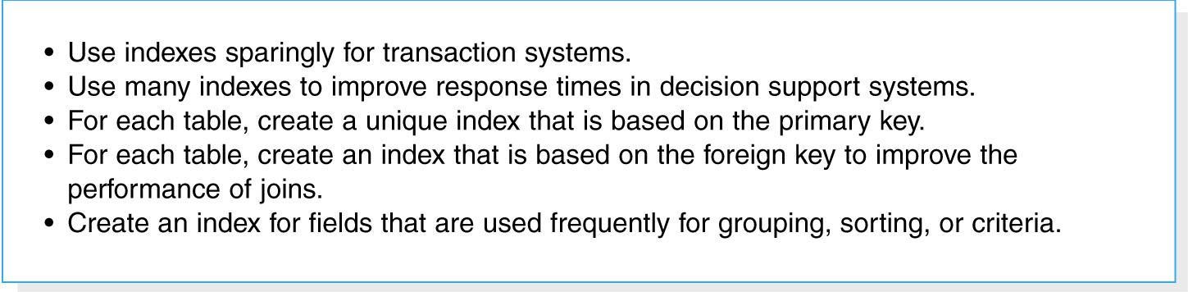
(cont’d)
Guidelines for creating indexes
© Copyright 2011 John Wiley & Sons, Inc.
11-‹#›

Slide 37
Estimating Storage Size
Volumetrics – technique of estimating the amount of data that the hardware will need to support.
1. Calculate the amount of raw data - all the data that are stored within the tables of the database.
2. Calculate the overhead requirements based on the DBMS vendor’s recommendations.
3. Record the number of initial records that will be loaded into the table, as well as the expected growth per month.
© Copyright 2011 John Wiley & Sons, Inc.
11-‹#›

Slide 38
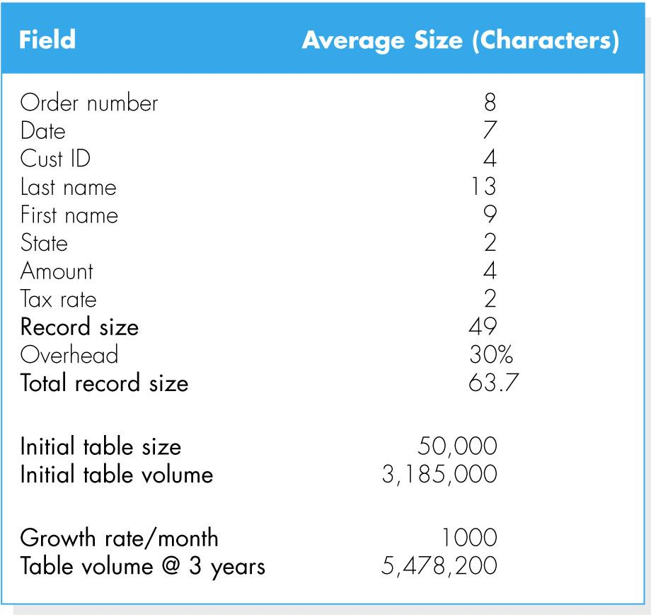
(cont’d)
Example of calculating volumetrics
© Copyright 2011 John Wiley & Sons, Inc.
11-‹#›

Slide 39
SUMMARY
File data storage formats
- Files are electronic lists of data.
- Five types of files: master, look-up, transaction, audit, and history.
Database storage formats
- A database is a collection of groupings of information
- A DBMS is software that creates and manipulates these databases.
Selecting a data storage format
- Relational databases support simple data types very effectively, whereas object databases are best for complex data.
© Copyright 2011 John Wiley & Sons, Inc.
11-‹#›

Slide 40
(cont’d)
Physical entity relationship diagrams
- Physical ERDs contain references to how data will be stored in a file or database table, and metadata are included.
Optimizing data storage
- There are two primary dimensions in which to optimize a relational database: for storage efficiency and for speed of access.
- There are a number of techniques of optimizing data storage.
© Copyright 2011 John Wiley & Sons, Inc.
11-‹#›

